Slide 1


Introduction to Business Intelligence
Business Intelligence (BI) refers to the technology-driven process for analyzing data and presenting actionable information to help executives, managers, and other corporate end users make informed business decisions.

Slide 2
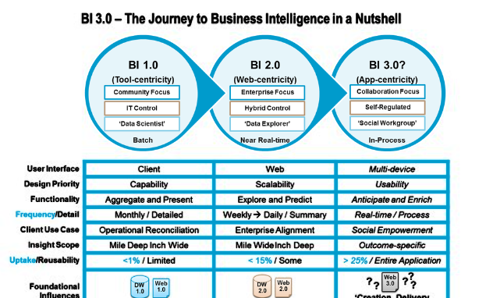

Definition and Importance of Business Intelligence
Definition
Importance
BI involves the use of software and services to transform data into actionable insights. It provides historical, current, and predictive views of business operations.
BI helps organizations identify market trends, discover new business opportunities, optimize operations, and make smarter decisions.

Slide 3
Key Components of Business Intelligence
Data Warehousing
Data Mining
Online Analytical Processing (OLAP)
Centralized storage of data from different sources for analysis and reporting.
Process of discovering patterns in large datasets to transform data into meaningful information.
Ability to analyze multidimensional data interactively from multiple perspectives.

Slide 4

Data Collection and Integration
1
Identify Data Sources
Identify and consolidate data from various internal and external sources.
2
Data Cleaning and Integration
Cleanse and integrate the data to ensure accuracy and consistency.
3
ETL Process
Extract, transform, and load data into the BI system for analysis and reporting.

Slide 5
Data Analysis and Reporting
1
Data Exploration
2
Statistical Analysis
3
Dynamic Reporting
Explore vast amounts of data to discover trends, patterns, and insights.
Utilize statistical methods to interpret data and make informed decisions.
Generate interactive and dynamic reports for real-time decision-making.

Slide 6
Data Visualization and Dashboards
Visual Representation
Interactive Dashboards
Present data and insights visually through charts, graphs, and infographics.
Create interactive dashboards for monitoring key performance indicators (KPIs) and metrics.

Slide 7




Business Intelligence Tools and Technologies
Self-Service BI Tools
Allow end users to access and analyze data without IT intervention.
Advanced Analytics
Utilize predictive and prescriptive analytics for deeper insights and decision support.
Cloud-Based BI Solutions
Offer scalable and flexible BI solutions through cloud platforms.

Slide 8


Benefits and Advantages of Business Intelligence
Operational Efficiency
Competitive Advantage
Enhance operational efficiency through data-driven decision-making and process optimization.
Gain a competitive edge by leveraging insights to improve product offerings and customer experience.

Slide 9

Challenges and Limitations of Business Intelligence
Data Quality Issues
Complex Implementation
Challenges related to data accuracy, completeness, and consistency can impact BI results.
Implementing BI solutions can be complex and require significant resources and expertise.

Slide 10

Future Trends in Business Intelligence
1
Augmented Analytics
Integration of AI and machine learning for automated insights and decision support.
2
Embedded BI
Integration of BI capabilities within everyday business applications for seamless access to insights.
3
Real-Time Analytics
Shift towards real-time data processing and analytics for faster decision-making.

Slide 11
THANK YOU

